Slide 1
Cognizant Virtual Internship
Task2: Predicting Stock Level Price
Abdulfatai Ameen Magobon

Slide 2
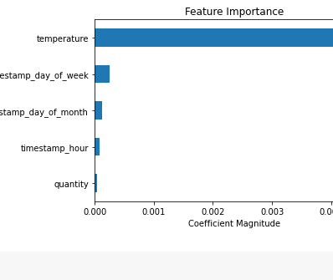
This feature importance visualisation tells us:
- The product categories were not that important
- The temperature was the most important in predicting stock
- The day of the week and month was also important for predicting stock

